Slide 1

Sons of Mother Seton
Columbiettes
Auxiliary #9847
St Elizabeth Ann Seton Catholic Church
1000 Andrews Road
Fayetteville, NC 28311

Slide 2
Our Origins
In 1939, Monsignor J. Francis McIntyre, at that time Chaplain of the New York Chapter Knights of Columbus, and who later became Cardinal McIntyre of Los Angeles, California, seeing great numbers of women coming out of a rally at Madison Square Garden, conceived the idea of a ladies organization to work with the Knights of Columbus.
Learn more here: About Us

Slide 3
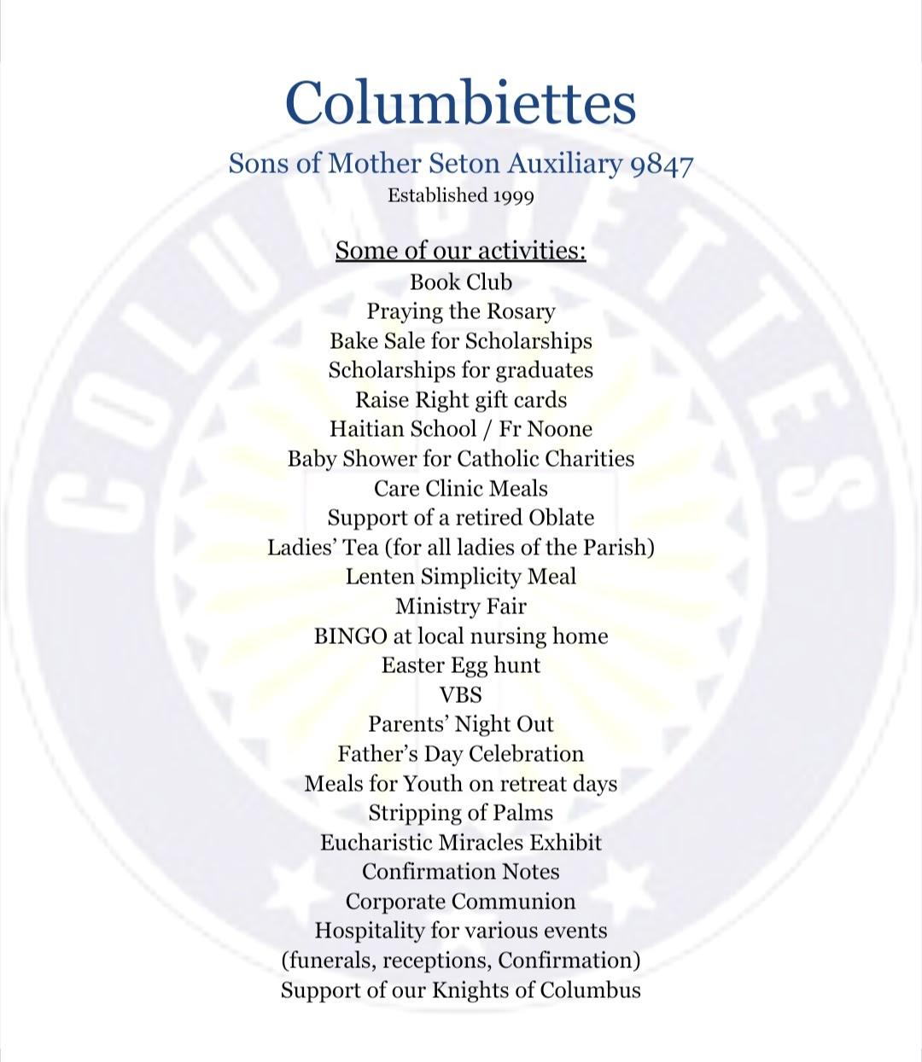
What do we do?

Slide 4

Our Organization’s Leadership
To learn more, visit their website: President Message

Slide 5
Columbiettes’ Mission Statement
The Columbiettes exist to promote service, sisterhood, and spirituality, and to protect the religious, civil, and economic rights of all people. They volunteer their time with the homeless, elderly, homebound, the unborn, and their communities. The organization is inclusive, respects ife, and supports the Knights of Columbus.

Slide 6
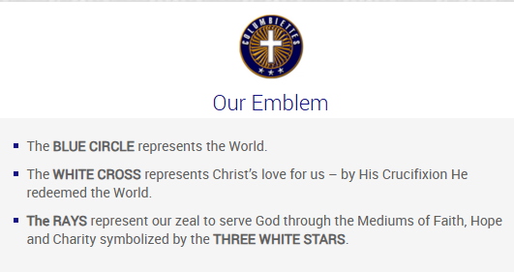

Slide 7
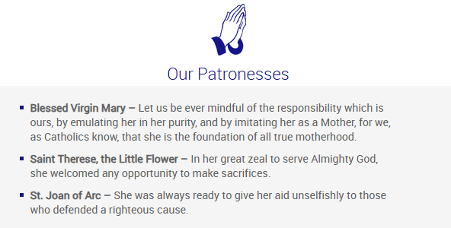

Slide 8

Your 2025 Officers
President - Diane Scherr
Vice-President - Jill Austin
Secretary - temp filled by J Austin
Treasure - Debra Beatty
Financial Secretary - Ann Mulvaney
Sentinel - Gloria Williams

Slide 9
UPCOMING ACTIVITIES
March 12 - Meals for the Care Clinic
March 28 - 10 AM - Stripping of Palms
March 29 - 9 AM - Corporate Mass
April 25 - K of C Golf Tournament
April 25/26 - Spring Bake Sale
May - Baby Shower for Catholic Charities
State Convention - May 29 - 30
June - Father’s Day Ice Cream Social

Slide 10


Slide 11
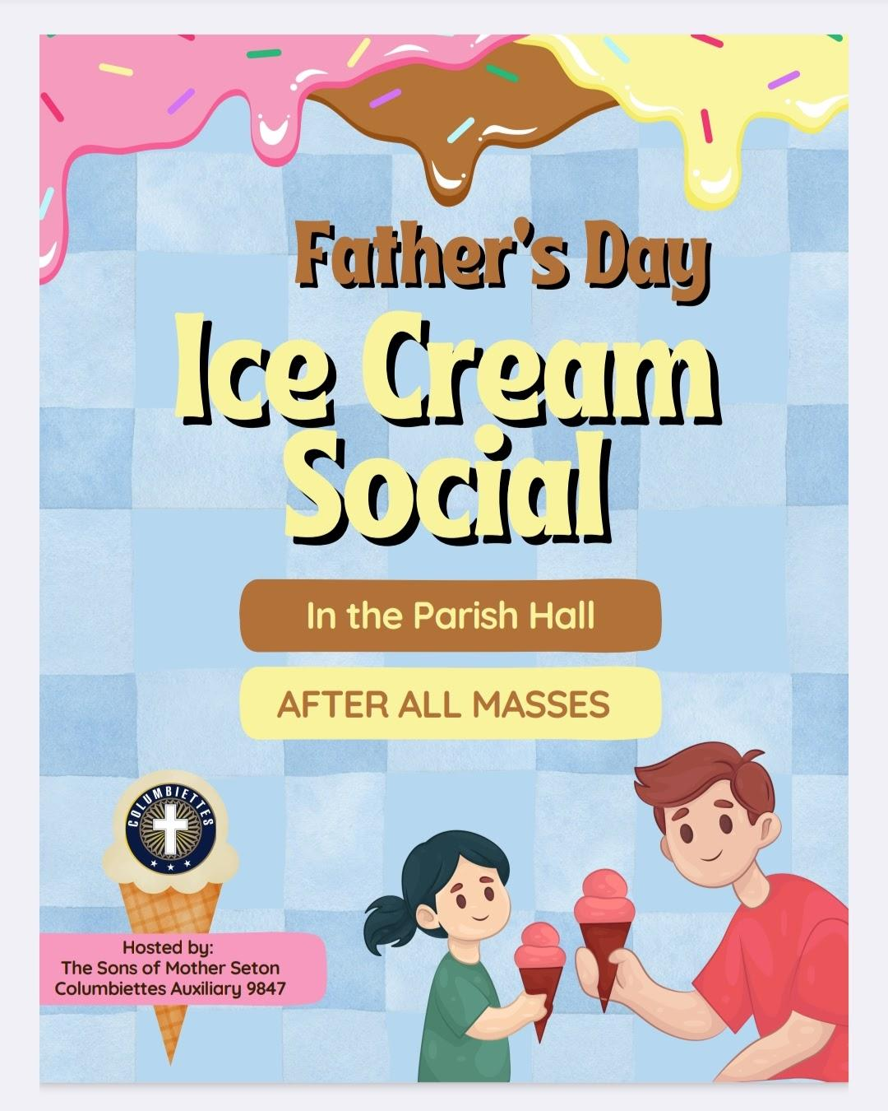

Slide 12
RAISE RIGHT GIFT CARD PROGRAM
We sell gift cards through the RaiseRight Program. You receive the full value of the card, and the retailer gives a percentage to the Columbiettes. There are hundreds of retailers to choose from!
Website link: https://columbiettes9847.com/scrip/

Slide 13
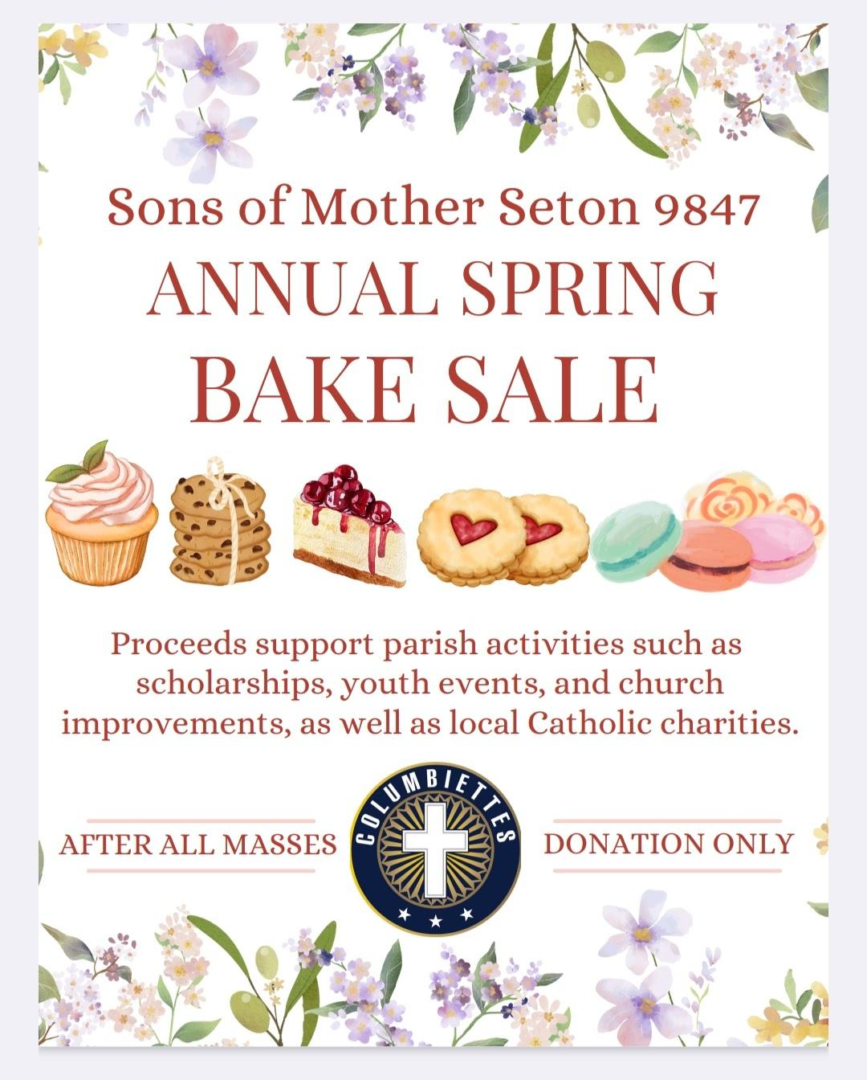

Slide 14
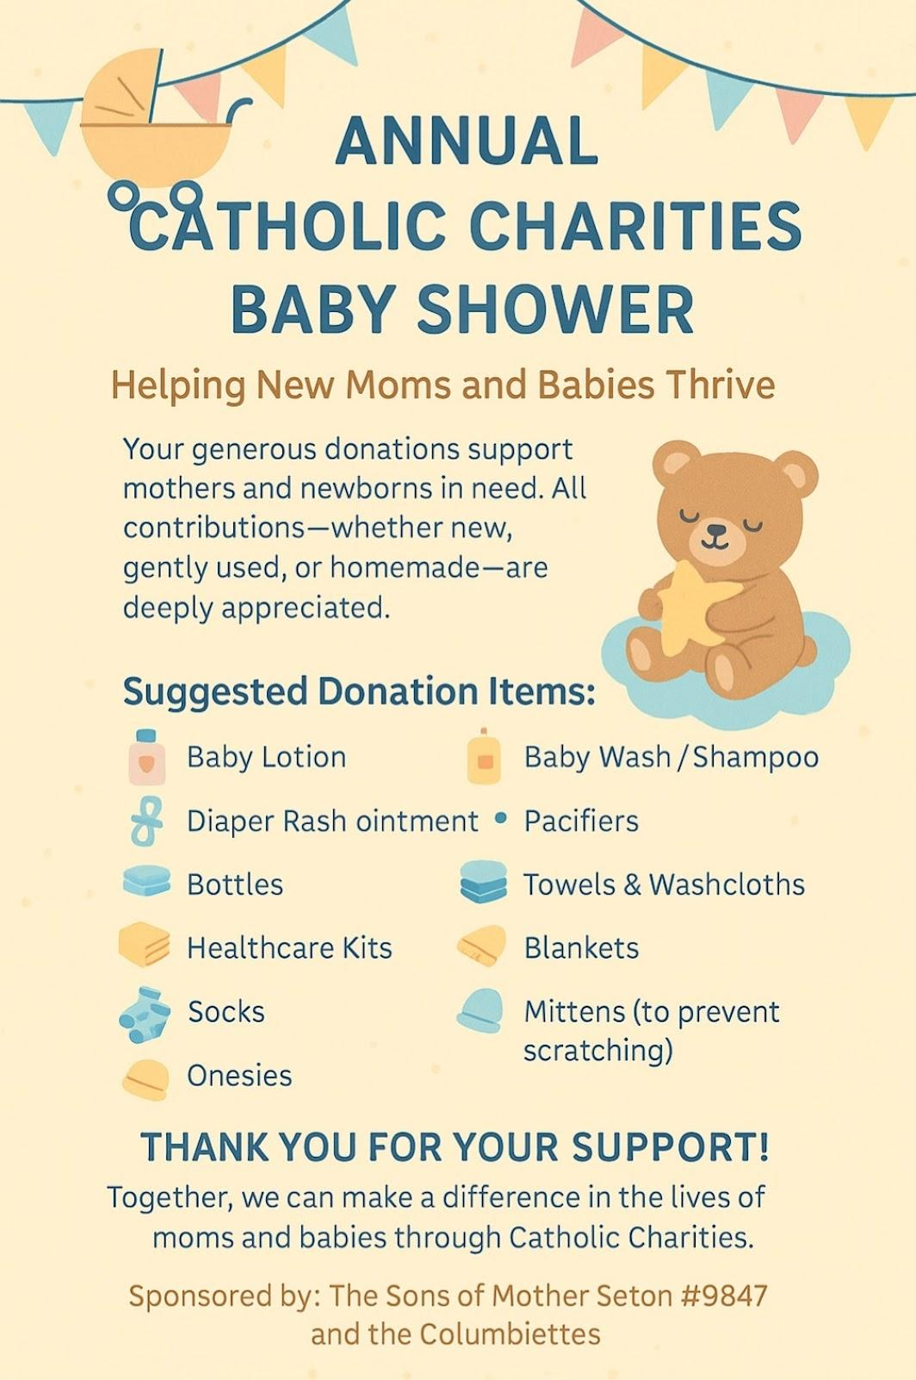

Slide 15
Social Media Links
Facebook link: https://www.facebook.com/Columbiettes9847/
Church website:
https://columbiettes9847.com/purpose/

Slide 16
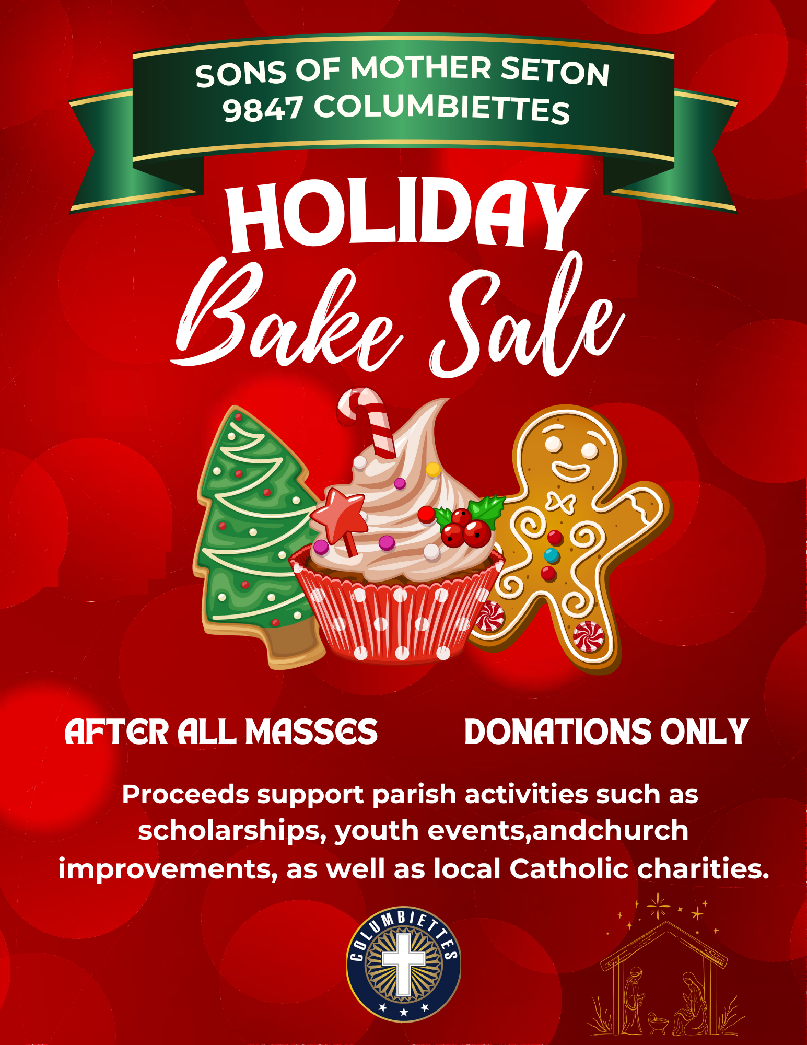


Slide 17
Visit Our New Store
https://shop.columbiettes.com

Slide 18
CATHOLIC TRIVIA
Take a look at the next two slides to see what you know - or think you know -
about all things Catholic!

Slide 19
Who is called the patron saint of missions even though she never left the convent? Saint Therese
What Future apostle stood by watching the stoning of the church’s first martyr, Stephen? St. Paul
What colors are the papal flag? White and yellow
Who is the inspiring sister who won the Nobel Peace prize for her work with the poor of India? Mother Teresa
What does “Easter Duty” mean? Confession at least once a year
Who are the men in colorful costumes who have been responsible for the personal safety of the Pope since 1506? The Swiss Guards
In St John’s Gospel, who is called the “Word of God”? Jesus

Slide 20
8 - What is the shortest book in the New Testament? The Epistle of St. Jude
9 - Who was the first American citizen to be canonized a saint?
Frances Xavier Cabrini
10 - Which Old Testament prophet was taken up to heaven in a chariot of fire?
Elijah
11 - What is the name of the cup form which the Precious Blood is served at mass?
Chalice
12 - What does the word “amen” mean? So be it
13 - What is the name of the hat worn by Bishops? Mitre
14 - What was the name of the pope who said: “I am a prisoner of the Vatican”
Pope Pius IX
15 - What is the name of the large, colored vestment that the priest wears for Mass?
Chasuble

